Slide 1
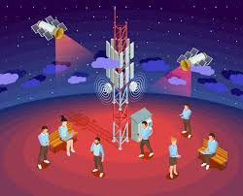
ADVANCED MOBILE COMMUNICATION SYSTEMS
Unit-1 - Introduction

Slide 2
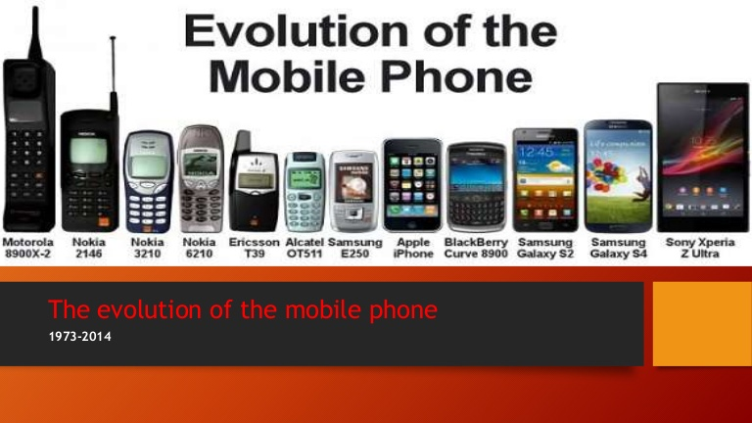

Slide 3
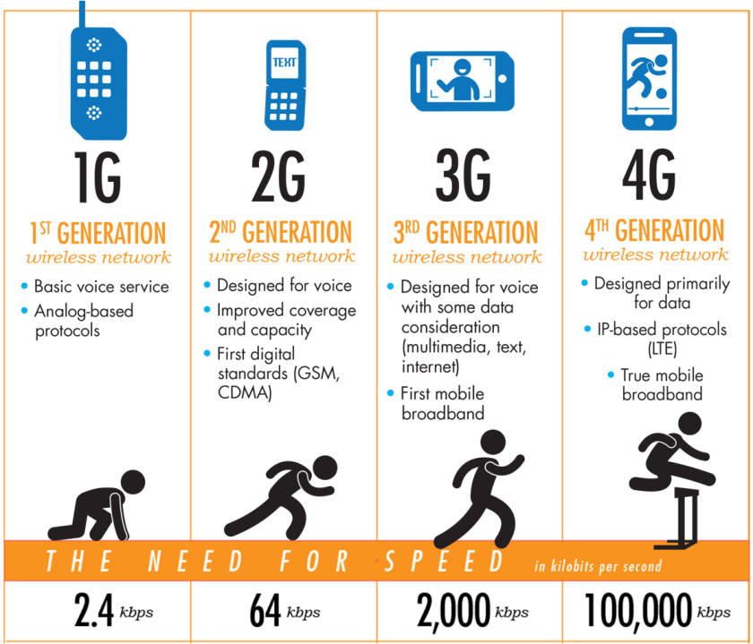

Slide 4
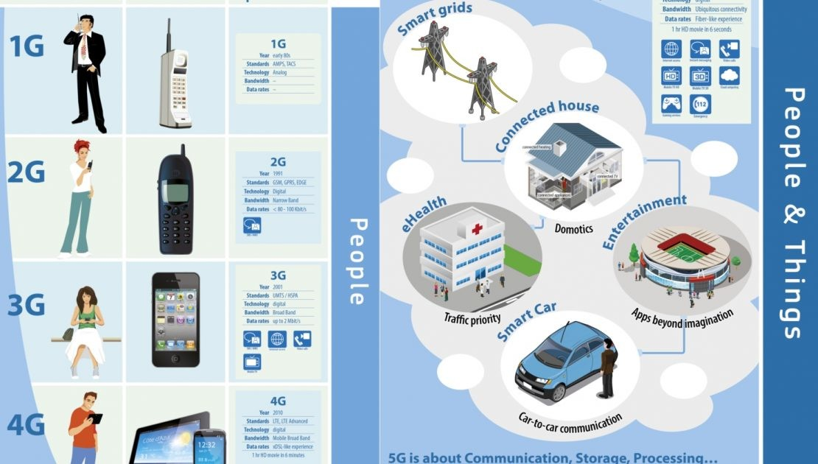

Slide 5
When we describe mobile communication, we refer to technology speed and bandwidth and frequency and system in numeric generations such as 3G, 4G and 5G.
1G:
These generations is introduces in the late 70’s. The radio signals used by 1G are analogue; in this larger amounts of data can be carried more easily.
2G:
The second generation was introduced in 90’s. It enabled digital voice and data to be sent across the network. It ensured privacy of phone calls. The introduction from 1G to 2G included among services that we use today, e.g. sms, internal roaming, conference calls, and call hold.
2.5 G:
In the year 2000 and 2003 included an advance in technology and it allowed high speed data transfer and internet. This included GPRS (General Packet Radio Services). This ensures flexible data transmission.
3G:
In 2001, the third generation mobile communication ensured greater voice and data capacity. It facilitated data transmission at a lower cost. This allowed video calls, chatting and conferencing, and mobile TV.

Slide 6
4G:
In 2010 the fourth generation was introduced, this is an IP based network system; It provides high speed, high quality and high capacity.
The advantage of this IP based network is that is introduced the LTE standard which support packet switching and all IP networks.
5G:
5G is the next generation commercial cellular network; it includes greater internet connectivity speed.
5G network will be initiated around 2020. One of the main advantages of 5G is IOT (Internet of Things).
Internet of Things (IOT):
The idea of IOT (Internet of things) is to allow devices to connect, respond, adopt and influence one and another. Imagine sitting and waiting for your car to warm up your alarm clock tells your car that you are awake and initiates heating.
High speed broadband services are now widely accessible and the costs associated with it have decreased significantly. Now companies are introducing Wi-Fi.
5G is a great achievement; by adhering to it we will be entering a new technological era. 5G will start in 2020; it’s faster than 4G so the speed of 5G and frequency will give us a stepping stone for new technology and its usage.

Slide 7
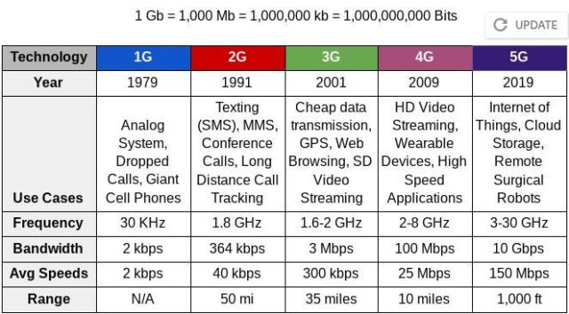

Slide 8
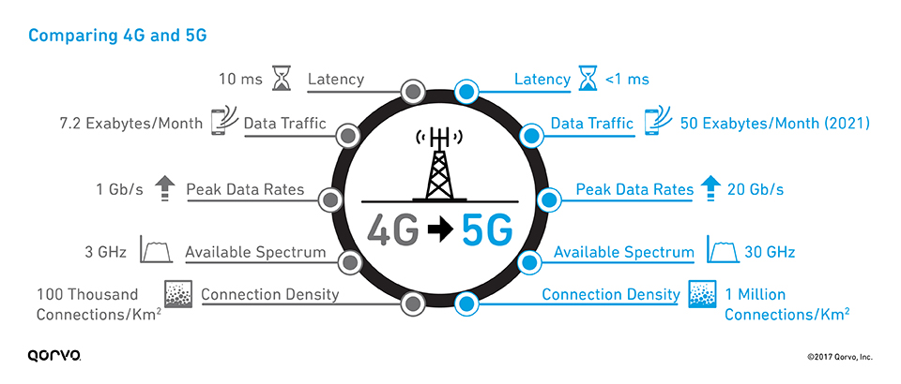

Slide 9
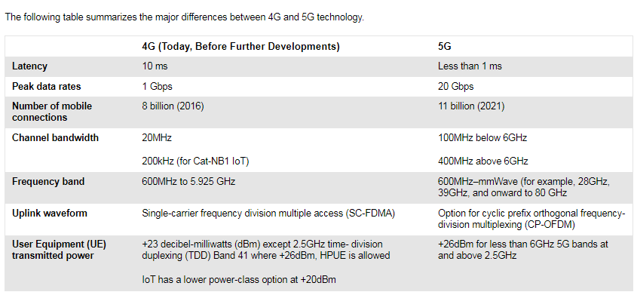

Slide 10
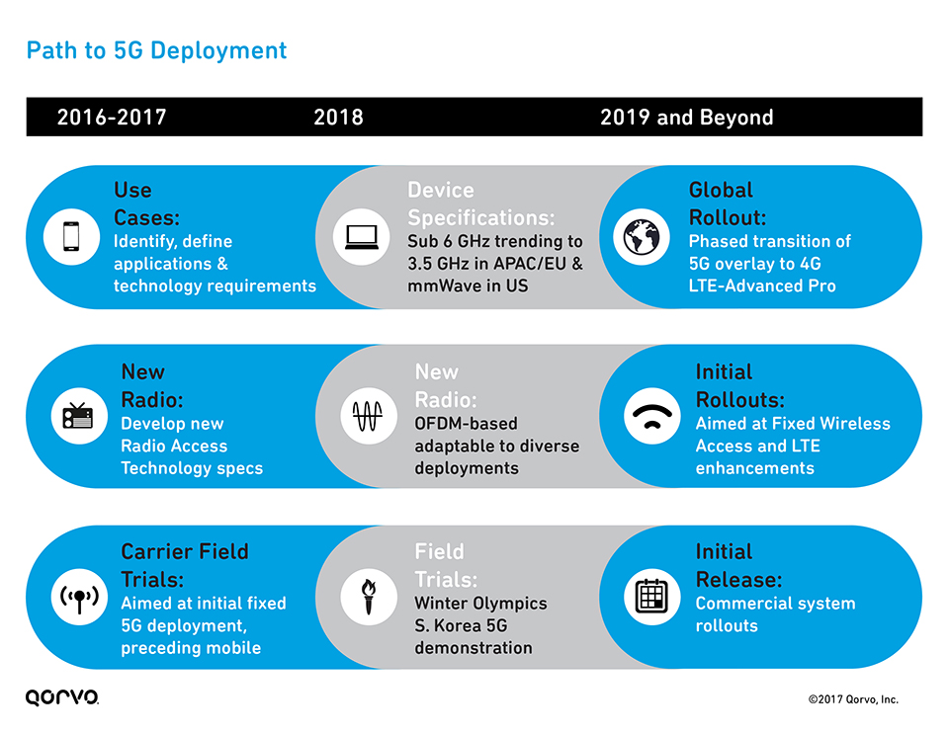

Slide 11
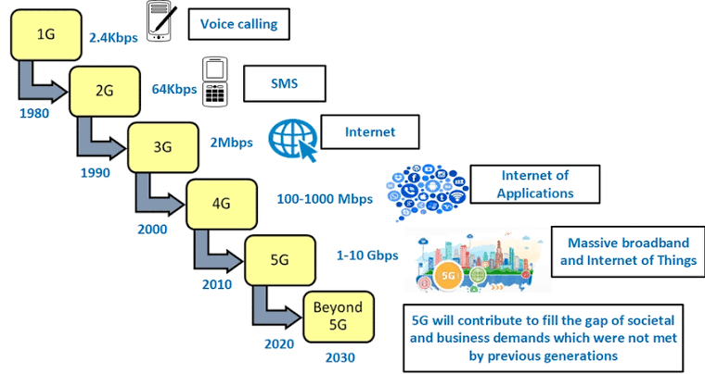

Slide 12
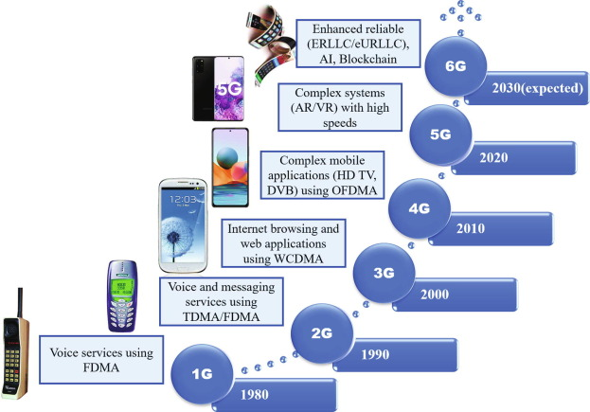

Slide 13
